Slide 1

Student Voices Panel

Slide 2

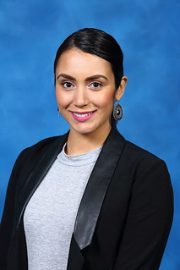

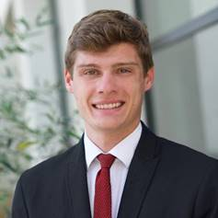
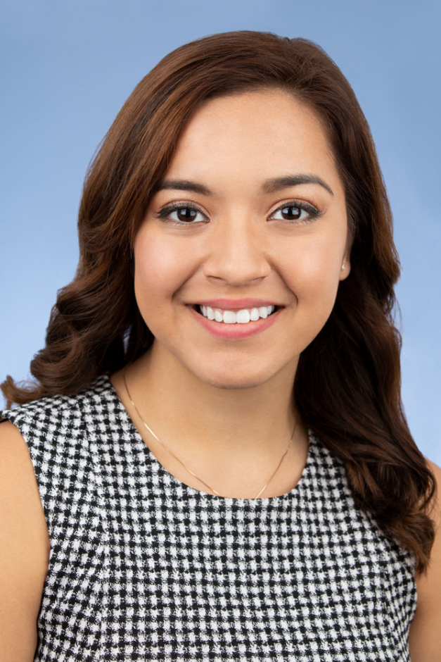

Hear Their Stories

Slide 3
Slido.com Instructions
Go to Slido.com
2) Enter code: G057
3) Q&A to follow.

Slide 5
SEARS Survey Answer #1
A combined 64% of students said the biggest obstacle to completing college was the cost or balancing work and their studies.

Slide 7
SEARS Survey Answer #2
The average monthly cost of living expenses for students in CA is $2,020.

Slide 9
SEARS Survey Answer #3
33% of students said they have experienced food or housing insecurity in any given month.

Slide 10
Student Voices Panel
Audience Questions

Slide 11
Thank You!
For additional information about SEARS, visit www.csac.ca.gov/sears

